Slide 1
Subqueries

Slide 2
Subqueries
A subquery is:
A query that is placed inside another query
A SELECT statement that is embedded within another SELECT statement
A request requiring a subquery is a two-part statement that contains an inner query and an outer query

Slide 3
Subqueries
The query that is placed inside another query is called the inner query and is run first
The inner query returns a result set of value(s), which the outer query uses in its search condition

Slide 4
Subqueries
There are two types of subqueries:
Single-row subquery, which returns a single row to the outer query
Multiple-row subquery, which returns multiple rows to the outer query

Slide 5
Single-Row or Single-Value Subquery
A single-row or single-value subquery is a nested inner subquery that uses the single-row operators >, =, >=, <, <=, and <> and returns only one row from the inner query
It is used when the result set of the outer query is determined on a single value from the inner query

Slide 6
Single-Row Subquery
List employees from the EMPLOYEES table for whom the employee salary is greater than the average salary for all employees?
This would require two queries:
Determine the average salary for all employees – INNER Query
Determine which employees have an above-average salary – OUTER Query

Slide 7
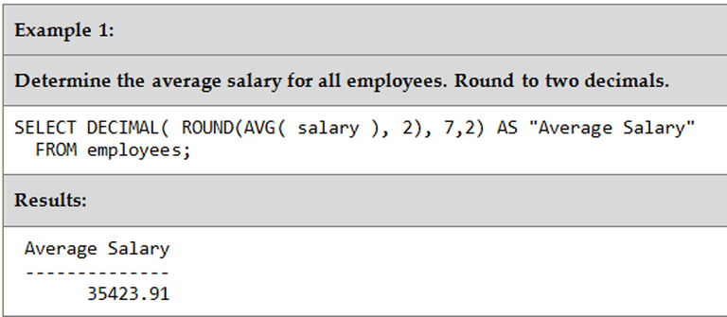
Example 1 Single-Row Subquery
Determine the average salary for all employees

Slide 8
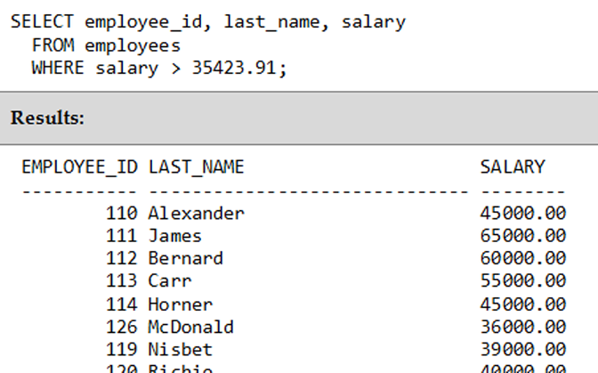
Example 2 Single-Row Subquery
Determine which employees have an above-average salary

Slide 9
Subquery
A subquery:
Begins with the SELECT keyword
Followed by:
A list of columns or expressions
A FROM clause
Optional WHERE, GROUP BY, and HAVING clauses
Does not allow an ORDER BY clause or a UNION operator

Slide 10
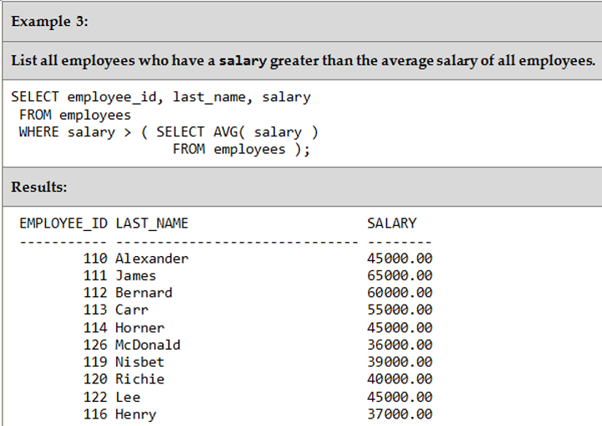
Example 3 Single-Row Subquery

Slide 11
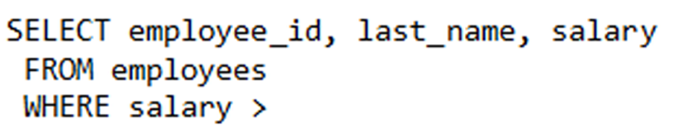
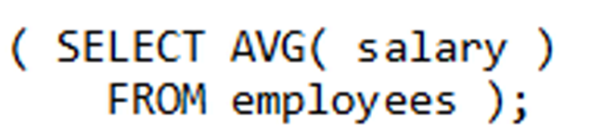
Single-Row Subquery
The outer query:
The inner query:

Slide 12
Multiple-Row Subquery
A multiple-row subquery is:
A subquery that uses the multiple-row operators IN, ANY, and ALL
Returns more than one row in the result set to the outer query

Slide 13
Multiple-Row Subquery - IN
List employees who have a salary equal to the highest salary of any department
This requires two queries:
INNER query to determine the highest salary for each department
OUTER query uses the list to determine which employee's have a salary equal to any of the salaries in the list

Slide 14
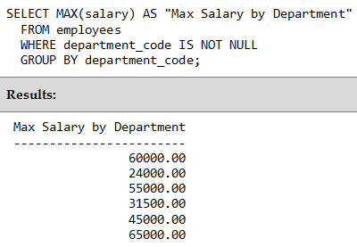
Example 4 Multiple-Row Subquery - IN
List the highest salary for each department

Slide 15
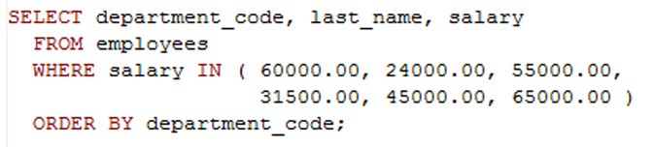
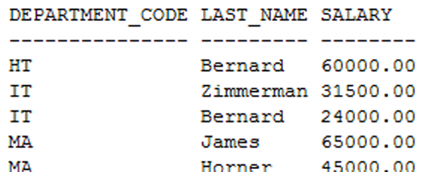
Multiple-Row Subquery IN Operator
Determine which employee's have a salary equal to any of the salaries in the list

Slide 16
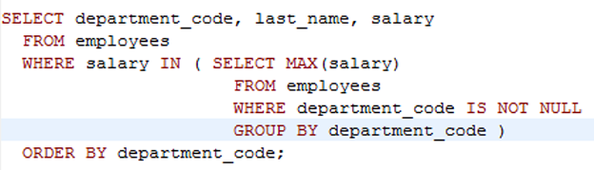
Example 5 Multiple-Row Subquery - IN
Determine which employee's have a salary equal to any of the salaries in the list

Slide 17
Multiple-Row Subquery ALL Operator
If the subquery is preceded by the ALL operator, the resulting condition is true if it satisfies all values produced by the subquery
Same as "highest value"

Slide 18
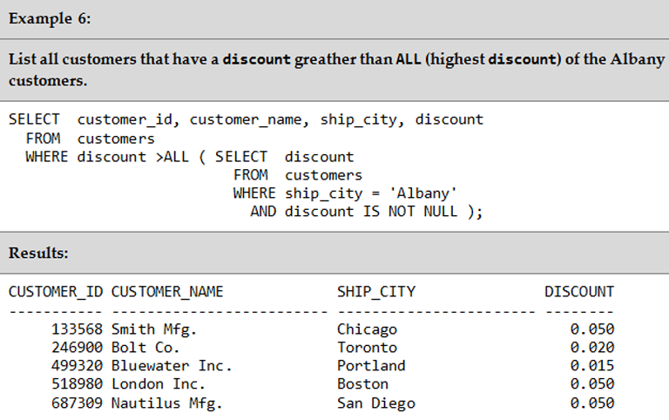
Example 6 Multiple-Row Subquery - ALL

Slide 19
Multiple-Row Subquery ANY Operator
If the subquery is preceded by the ANY operator, the resulting condition is true if it satisfies any value produced by the subquery
Same as "lowest value"

Slide 20
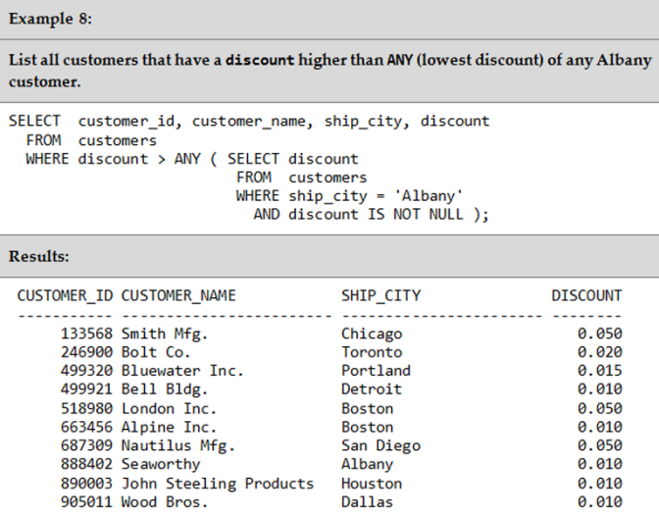
Example 8 Multiple-Row Subquery - ANY

Slide 21
Correlated Subquery
In Single-Row and Multiple-Row subqueries:
SQL evaluates the subquery once
Substituted the result of the subquery in the search condition
Evaluated the outer query based on the value of the search condition

Slide 22
Correlated Subquery
A correlated subquery is:
A SELECT statement nested inside another SQL statement, which contains a reference to one or more columns in the outer query
Executed several times while the outer query statement that contains it is processed

Slide 23
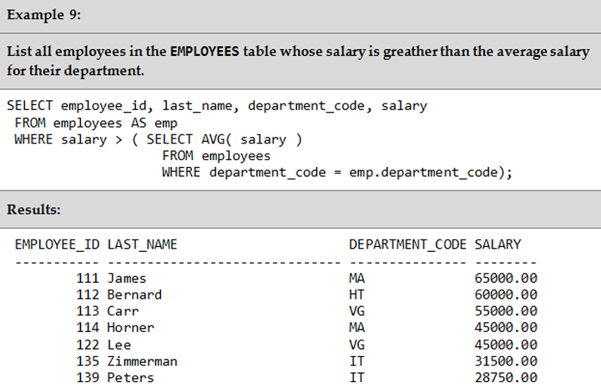
Example 9 Correlated Subquery

Slide 24
EXISTS Operator
The EXISTS operator requires a subquery
The condition specified with the EXISTS operator is true if the subquery result set contains one or more rows; otherwise, the condition is false

Slide 25
EXISTS Operator
If the EXISTS condition does not return at least one row, the outer query is not executed, and the entire SQL statement returns nothing

Slide 26
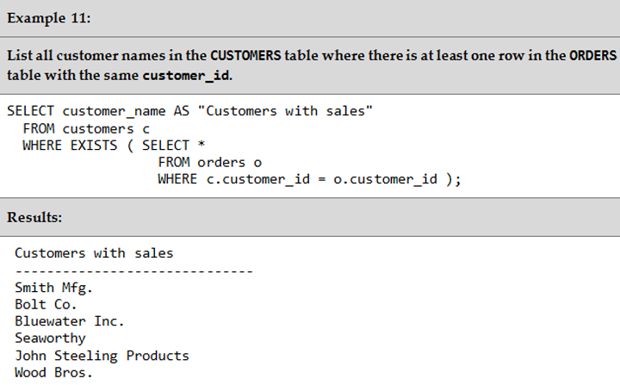
Example 11 EXISTS Operator

Slide 27
NOT EXISTS Operator
The NOT keyword can be specified before the EXISTS operator
The value of the negated condition will be true only if the subquery result set is empty

Slide 28
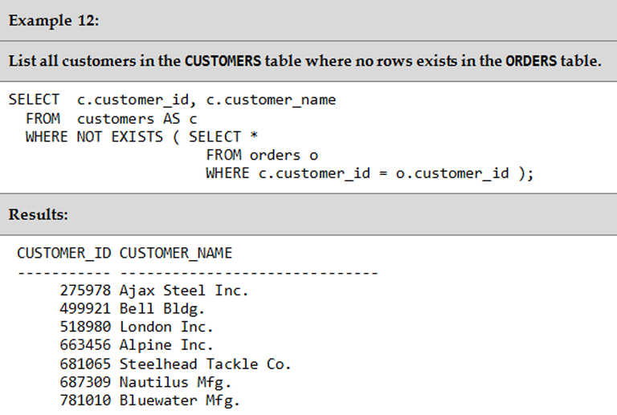
Example 12 NOT EXISTS Operator

Slide 29
Comparison Between JOIN, IN, EXISTS
Often, IN, EXISTS, and JOIN can be used to write the same query
IN operator is often less efficient than the same query using JOIN and EXISTS
JOIN and EXISTS are faster because they use the table index

Slide 30
Comparison Between JOIN, IN, EXISTS
Complete the following query using JOIN, IN, and EXISTS:
List customers from the customers table that have orders in the orders table

Slide 31
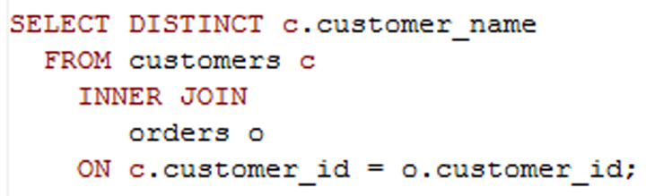
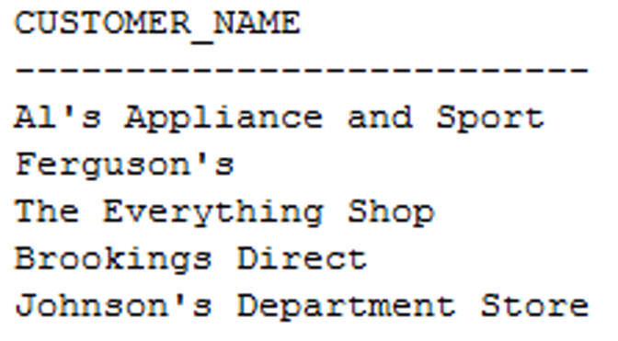
JOIN - order seems to be determined by the orders table

Slide 32
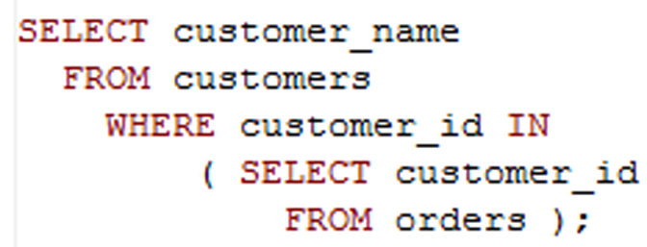
IN – order seems to be determined by the orders table

Slide 33
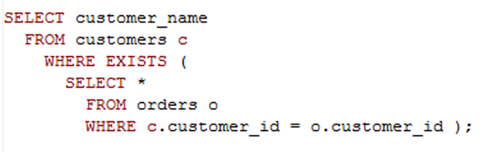
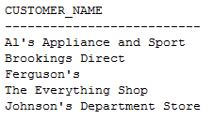
EXISTS – order seems to be determined by customers

Slide 34
The End ☺

